Slide 1
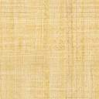
Name of the dish – Chole Kulchehole Kulchae
Name – KrishanshiBhartia
House.No – S/2252
Class- 7(A)

Slide 2
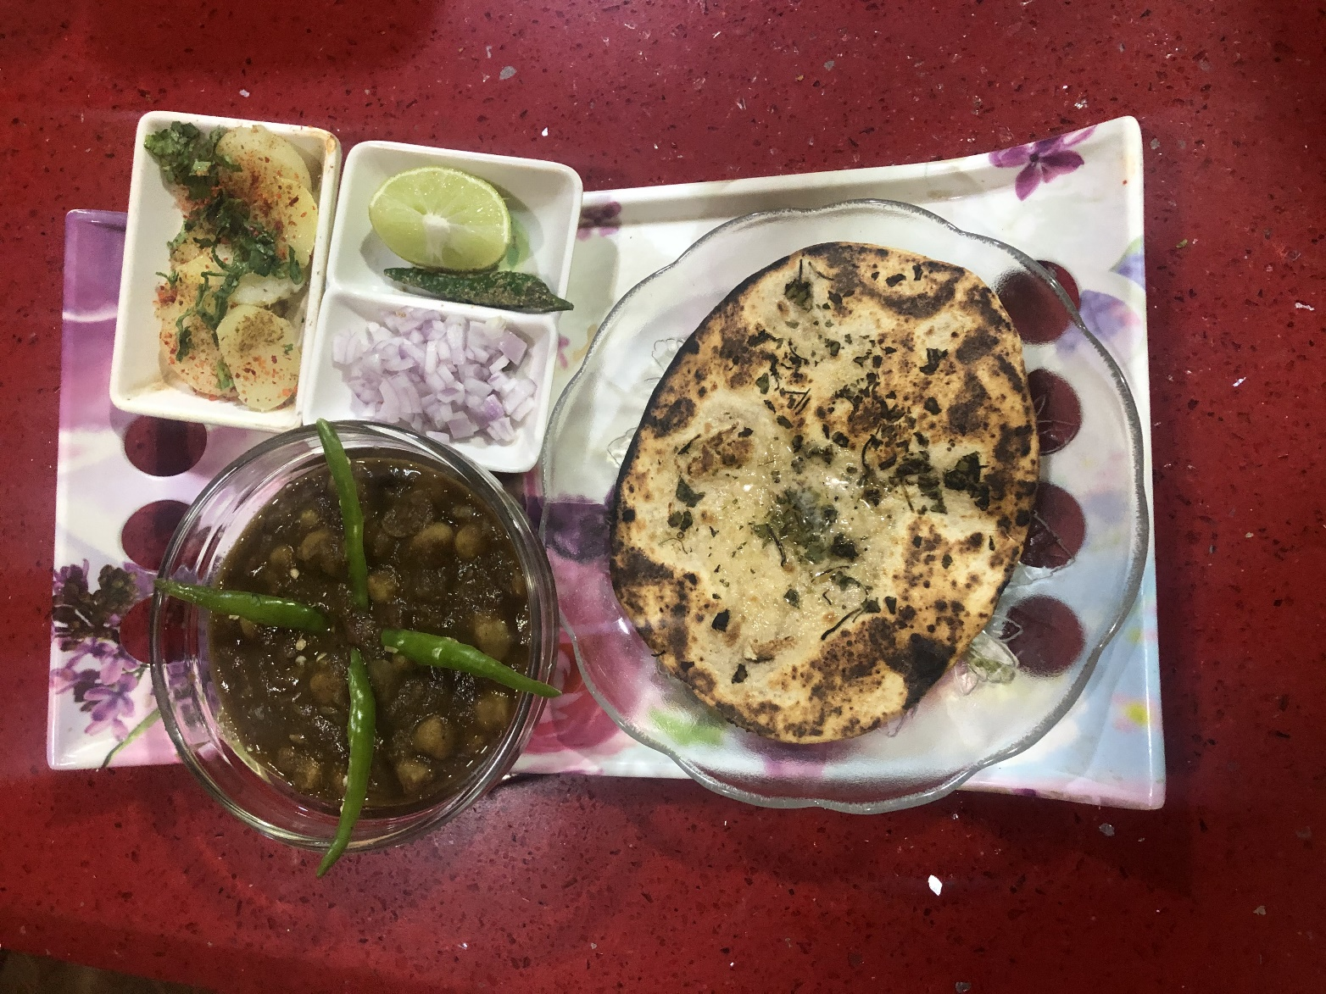
Chole Kulchae

Slide 3
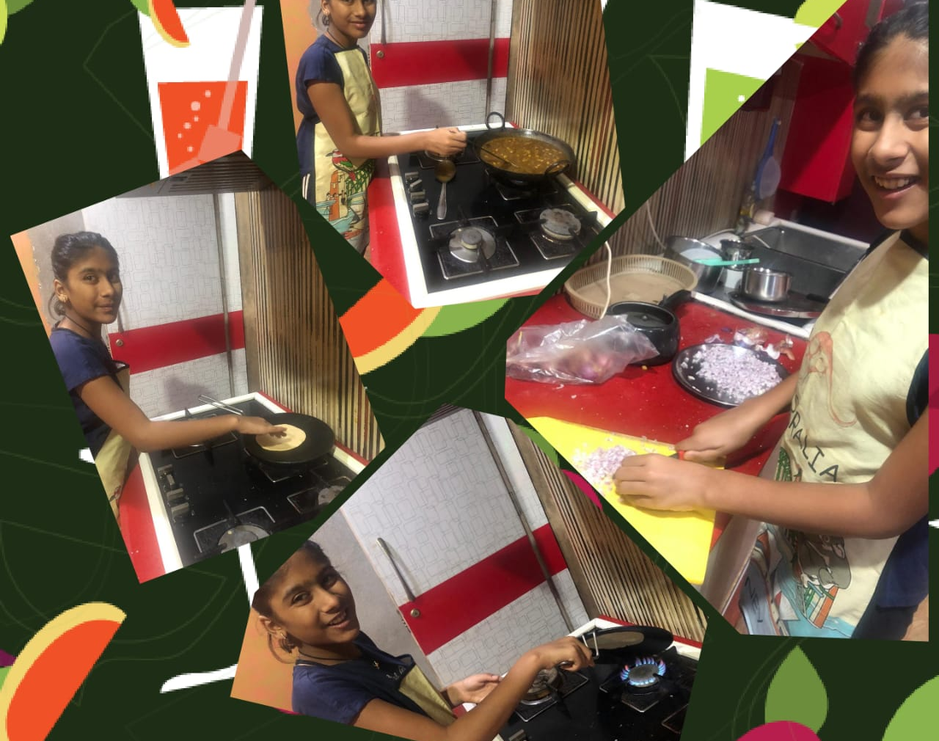
Reasons Behind me liking this Dish
I like this dish because as it has a varied taste and I can flavour all my taste like spicy, sour, the temperature of the dish and most of all this dish can be consumed in all the seasons. Chole can be had with chappatis, kulche, pooris and it can be used to have in a form of “Indian chats” also.
This dish is a popular Indian recipe from the Punjabi cuisine.
This dish is prepared during Baisakhi.

Slide 4
Recipe of the Chole
1
First pressure cook the soaked chole (chole have to be soaked overnight or for 8-9 hours) with the whole spices and tea bags or black tea leaves tied tightly in a muslin ,along with some black salt. The chole will get a nice dark color of the tea leaves. They should be completely cooked. Strain the chole/chickpeas and reserve the stock.
2
In a pan, heat oil and add chopped onions. Then we have to fry the onions till they become golden-brown.
3
Now add slit green chilies and fry for a minute and so the choles become spicy but if u don’t want spicy choles its not mindatory.
4
Now we have to add chopped tomatoes and ginger and saute the tomatoes till they become mushy and soft.

Slide 5
5.
Now we need to add the chole and saute them for five to six mins. After doing this much add the spices/ garam masala powder .
6
Now we need to stir the spice powders and saute them for a minute or 2.
7
Now we have to keep the whole mixture on fire and simmer till the gravy thickens a bit so we don’t have the watery chole. Adjust the spices and seasonings accordingly and as per your taste.
8
Now finally we have to stir it and now we will prepare the kulchae.

Slide 6
Recipe of Kulchae
Ingredients
. 2 cups flour
. 1 tsp dry yeast
. ½ tsp sugar
. 1 tsp oil
. ½ cup sour curd
. For kneading dough water
. A hot pan or (tava)

Slide 7
Method
Dissolve sugar in ½ cup lukewarm water and sprinkle yeast over it.
Leave it in a draught free place to forth.
When forthy, add salt, oil, curds, and yeast mixture to flour and knead to a soft dough with the lukewarm water and leave it to rise in a draught-free place covered with cling film or wet cloth.
When risened and doubled, punch and knead again leave to rise again.
Pre-heat the pan(tava)
Flatten the balls and roll thin.
Place the kulchas on the pan(tava) and cook one side partially till 1/4 cooked flip and cook the other side till it is ½ cooked. Apply ghee or oil on both sides of kulcha whilst cooking.
Cook it till both the sides have golden spots on them and are evenly cooked . At the end if u want u can topple “kasturi methi” on it.

